Slide 1
Implementation Design Approach presentation
SA00570532
Aashiq Ahamed SP

Slide 2
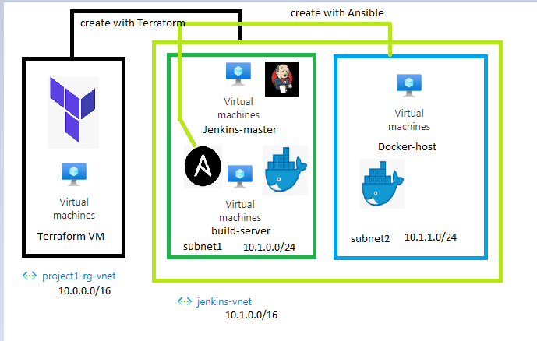
Azure resources and tools used for this project

Slide 3
Table of Resources
Resource | Name | Location
Resource group | jenkin-rg | East US
Virtual Network | jenkins-vnet | East US
Subnet | Subnet 1 | East US
Subnet | Subnet 2 | East US
Network Security Group | NSG | East US
Network Security Group | nsgdoc | East US
NIC | nicbuild | East US
NIC | Nicmaster | East US
NIC | Nicansi | East US
Public IP | publicipbuild | East US
Public IP | publicipmaster | East US
Public IP | Docpubip | East US
Virtual Machine | Vm-build | East US
Virtual Machine | VM-master | East US
Virtual Machine | Docvm | East US

Slide 4
Design above explained here
Using Terraform script created above resources in Azure.
Using terraform provisioned the VM-master with Jenkins and Java
Using Terraform Provisioned the vm-build with Java, Maven, Docker, Ansible, Azure CLI

Slide 5
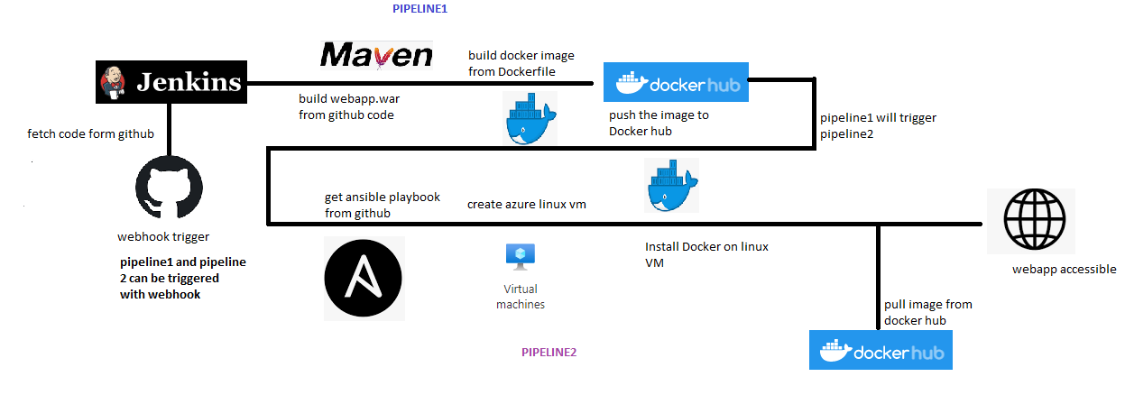
Jenkins pipelines

Slide 6
Design above explained here
Pipeline 1 triggers from commit in github through webhook and build docker image and push it to docker hub
Pipeline 2 is triggered after pipeline 2 successful completion and creates a docker host in azure vm, fetch image from docker hub and runs as a container

Slide 7
Highlights
Used Count parameter in terraform to create two resources wherever possible along with element parameter.
Used provisioner block in a null resource.
Used script file and pushed it to VM to execute for system requirements installation for this project.
Github webhooks used in master branch to trigger pipeline 1 and also for ansible branch for pipeline 2

